Slide 1
Circular economy
Apetrei Maia Teodora

Slide 3
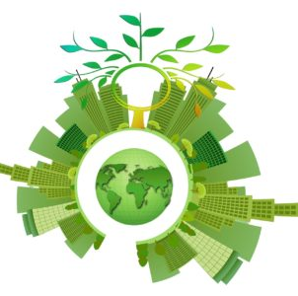
The circular economy is a model of production and consumption that involves sharing, reusing, repairing, renovating and recycling existing materials and products as much as possible. In this way, the product life cycle is extended. In practice, this involves minimizing waste. When a product reaches the end of its life, the materials from which it is made are kept in the economy whenever possible. They can be used again and again, thus creating additional value.
Most linear economy businesses take a natural
resource and turn it into a product which is ultimately destined to become waste because of the way it has been designed and made. This process is often sumarized by "take, make, waste".

Slide 4
The circular economy is a framework of three principles, driven by design: Eliminate waste and pollution, Keep products and materials in use and Regenerate natural systems. It is based increasingly on renewable energy and materials, and it is accelerated by digital innovation. It is a resilient, distributed, diverse, and inclusive economic model. The circular economy is an economic concept often linked to the sustainable development, provision of the Sustainable Development Goals and the green economy but which goes further than the latter. Indeed, rather than only think to reduce the ecological and environmental impact of the industries and the amount of waste, it aims to transform our economy into one that is regenerative. In other words, the goal is to make the economy as circular as possible, by thinking to new processes and solutions for the optimization of resources, decoupling reliance on finite resources.

Slide 5
The Principles Of The Circular Economy
At its core, a circular economy model has the intention of designing out waste. In fact, a circular economy is based on the idea that there is no such thing as waste. In order to achieve this, products are designed to last (good quality materials are used) and optimized for a cycle of disassembly and reuse that will make it easier to handle and transform or renew them.

Slide 6
In the end, these tight product cycles differentiate the circular economy model apart from disposal and recycling, where large amounts of embedded energy and labor are lost. The ultimate goal is to preserve and enhance natural capital by controlling finite stocks and balancing renewable resources flows.

Slide 7
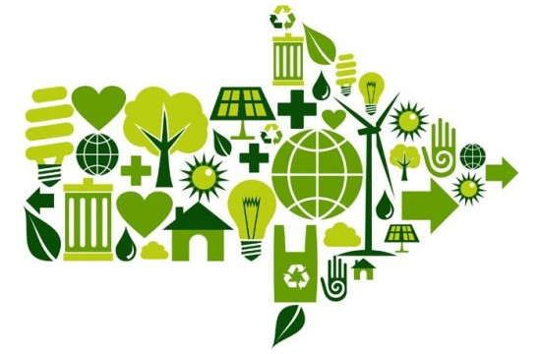
Benefits
Since the industrial revolution, humankind has been following a linear model of production and consumption. Raw materials have been transformed into goods that are afterward sold, used and turned into waste that has been many times unconsciously discarded and managed.
On the opposite, the circular economy is an industrial model that is regenerative by intention and design and aims to improve resources’ performance and fight the volatility that climate change might bring to businesses. It has benefits that are operational as well as strategic and brings together a huge potential for value creation within the economical, business, environmental and societal spheres.

